Slide 1



ABAP on Hana s/4 Hana Training
Day 16
contact@anubhavtrainings.com

Slide 2

Agenda – Day 16
Use Case
Flow of Use Case
Implementing Use Case
Creating Fiori App on top of CDS View
Defining Metadata Extension
Describing UI Annotations
Defining CDS BOPF
Define Business Object
Nodes of Business Object
Building BOPF Scenario
Development Flow & Artifact

Slide 3
Use Case
Aviation industry changed a lot and hard hit by pandemics. They are allowed to perform flight operations with COVID safety norms. As per aviation ministry most of the activities should be contact less. Which includes the luggage, boarding, sitting arrangement, aircraft sanitization and food deliveries. Now due to pandemic, the loading of food and beverages inside a flight is also changing.
My Customer asked me to develop a solution which can be used by food manager on the floor with his/her tablet to check the upcoming flights and assign the food items. A delivery manager thus check the assignment and approves it. On approval, the same will be picked by crew members from backyard of airport.
We are already on S/4HANA and we have following needs
A Fiori App which should be fast and accessible on tablet to view all the flights
User should be able to search the flights based on CARRID, CONNID
We should be able to create new entries for flight and assign meal for them
Also solution should allow Update and delete of flight meal records
Finally, An approval process is also required to approve flight meals assigned by food manager on floor.

Slide 4
Flow of Use Case
Metadata Extension CDS View.
Consumption CDS View.
Table – ZOFT_MEALS.
Draft Table - ZOFT_JUL_MEAL.
ZOFT_JUL_MEAL
ZOFT_MEALS
ZATS_CDS_BOPF
ZATS_MED_BOPF

Slide 5
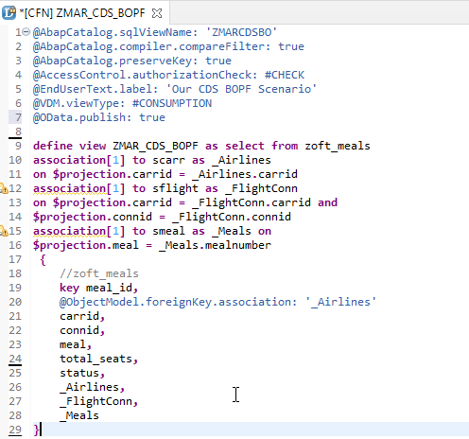
Exercise
CDS View Code
OData Exposure

Slide 6
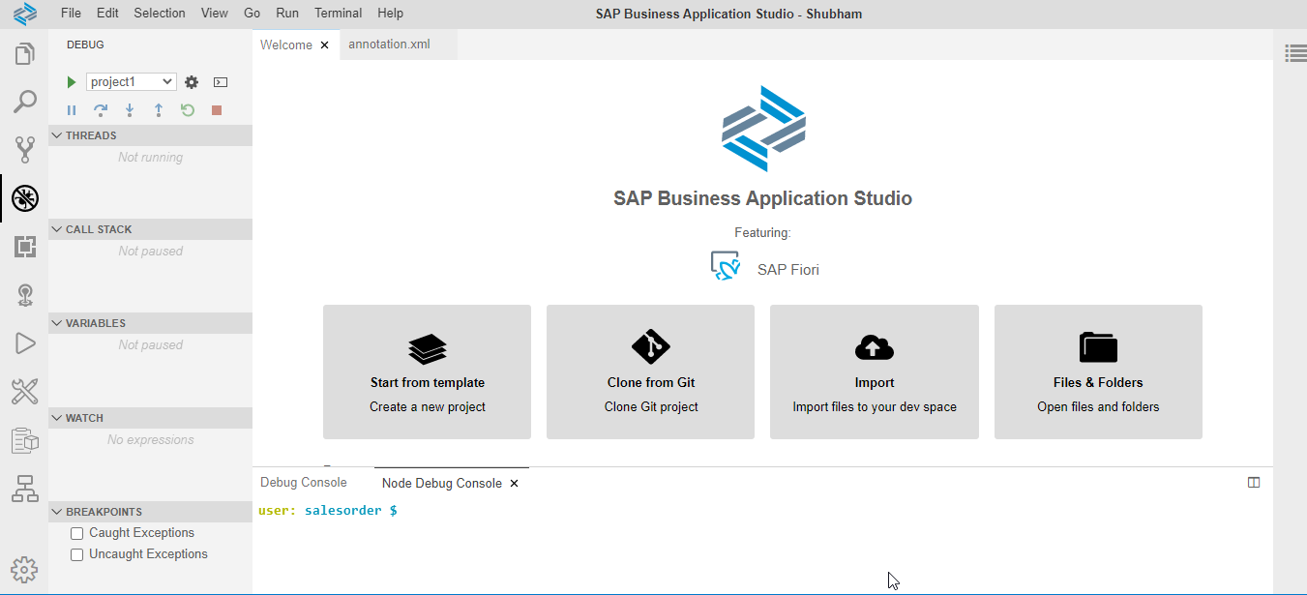
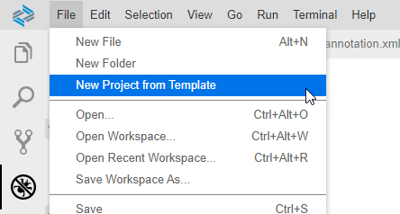
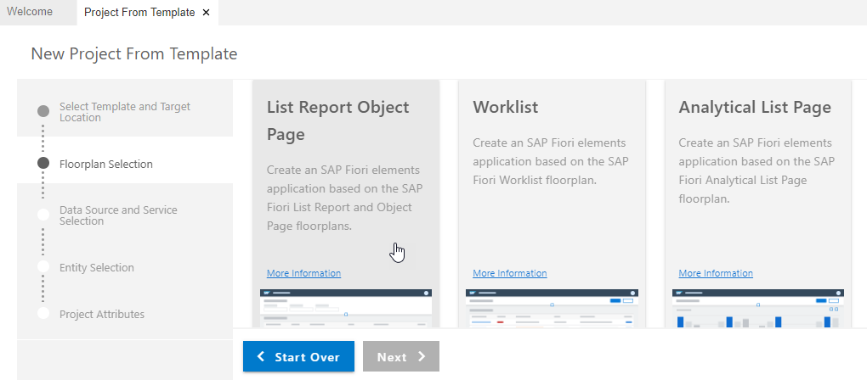
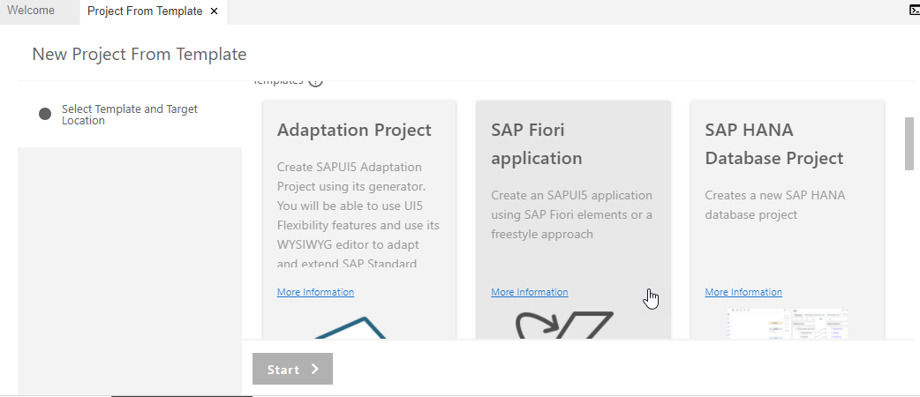
Create Fiori App with Template on BAS
Step 1. Open Business Application Studio.
Step 4. Choose List Report Object Page & Next.
Step 3. Click on SAP Fiori application & Next.

Slide 7
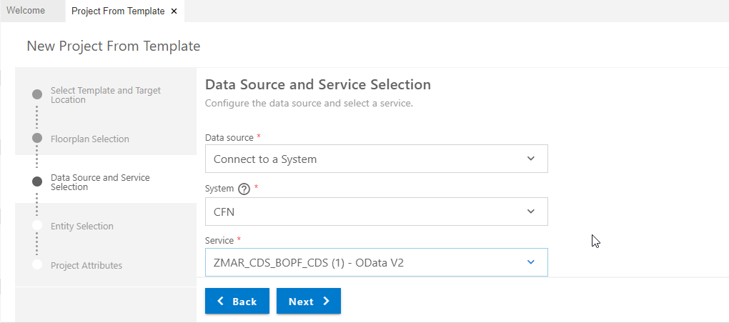
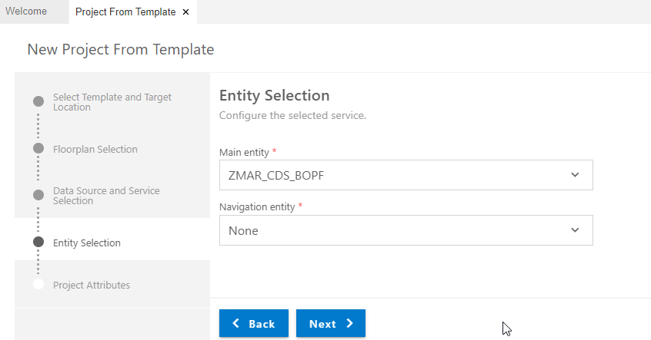
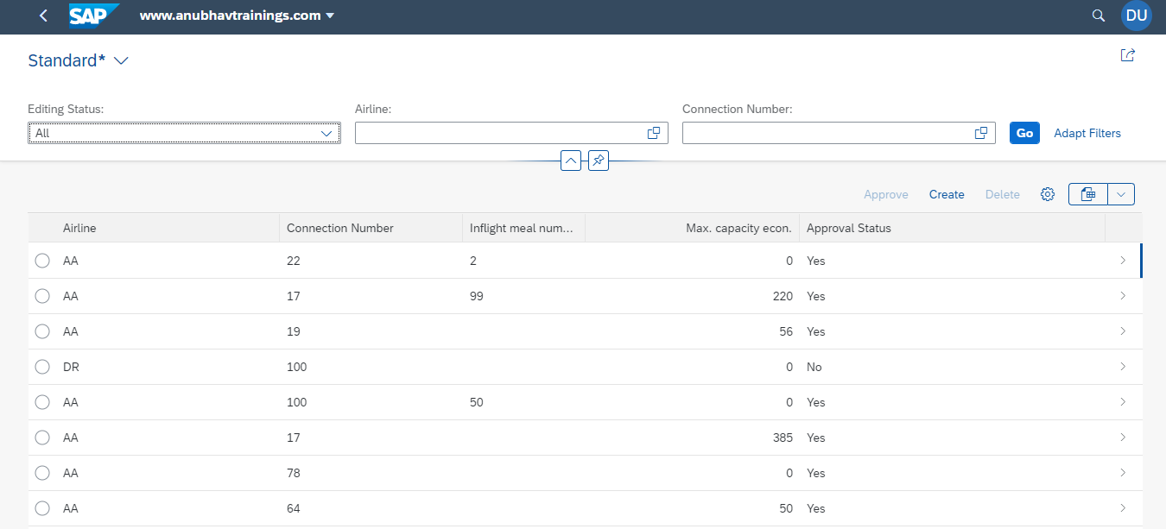
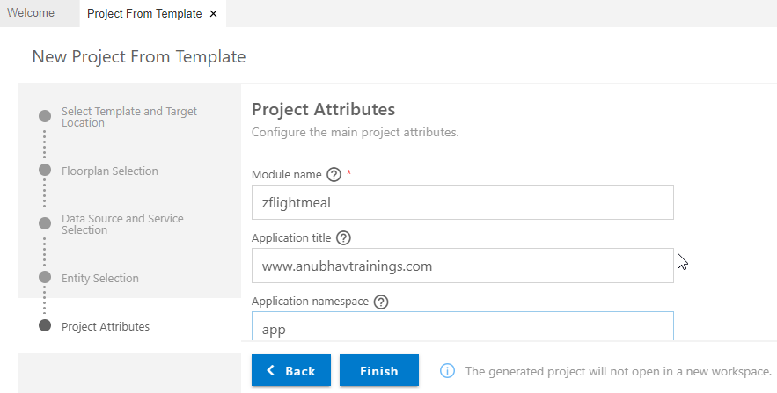
Create Fiori App with Template on BAS
Step 5. Enter Data Source & Select OData service.
Step 6. Entity Selection & Next.
Step 8. Run Project for Final output.
Step 7. Enter Project Attributes & Finish.

Slide 8
Gold Standard
In real-time application,
we bring statelessness to our application logic but our UI keeps on changing. Hence we separate the UI logic from business logic. Currently the UI logic is merged with app logic which create a risk when a developer change UI logic by mistake it can hamper the app logic.
When SAP develop an app using the same approach of annotations and deliver it to its customers and partners. What customers would need is to tweak the UI little bit.
Metadata Extension – is a new CDS artefacts which is developed to decouple the UI annotations from CDS view. SAP allows a layered approach, SAP deliver standard annotation code with layer #CORE and customers & partners can create another MDE file with layer #CUSTOMER or #PARTNER.
When app runs, it checks if there is #CUSTOMER annotation file, it will take highest prio and subsequently #PARTNER and #CORE.

Slide 9
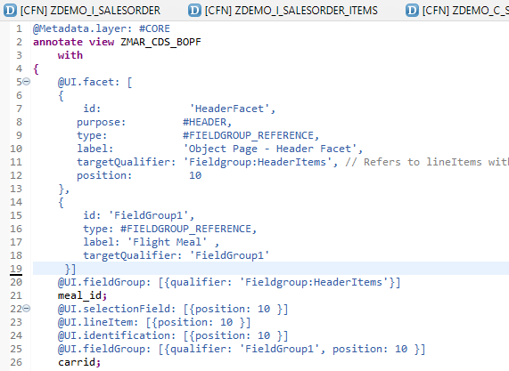
Meta Data Extension
A CDS metadata extension (MDE) extends a CDS entity with CDS annotations that are not defined in the CDS source code of the data definition. CDS metadata extensions can currently only be created for CDS views.
@Metadata.allowExtension: true
There can be several metadata extensions for one CDS entity. The following rules determine which metadata extension to use to evaluate the annotations:
Each metadata extension is assigned to a layer, such as branch, partner, or customer. The layer determines the priority of the evaluation.
A metadata extension can be joined to a CDS variant. The CDS variant can be specified during the evaluation of the annotations of a CDS entity to select the metadata extension.

Slide 10
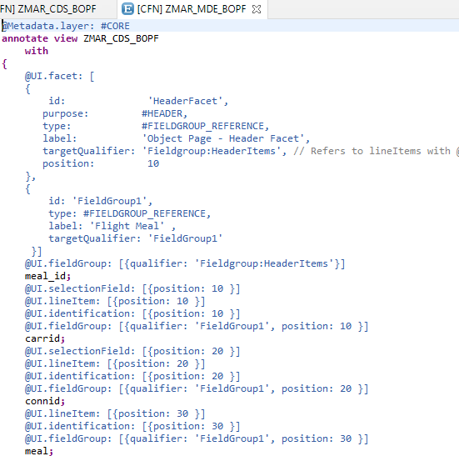
UI Annotations
Exercise :-
Metadata Extension Code for UI Annotation
Identification Annotation
Line item Annotation

Slide 11

CDS BOPF
The Business Object Processing Framework is an ABAP OO-based framework that provides a set of generic services and functionalities to speed up, standardize, and modularize your development. BOPF manages the entire life cycle of your business objects and covers all aspects of your business application development. Instead of expending effort for developing an application infrastructure, the developer can focus on the individual business logic. Using BOPF, you get the whole application infrastructure and integration of various components for free. This allows you to rapidly build applications on a stable and customer-proved infrastructure.

Slide 12
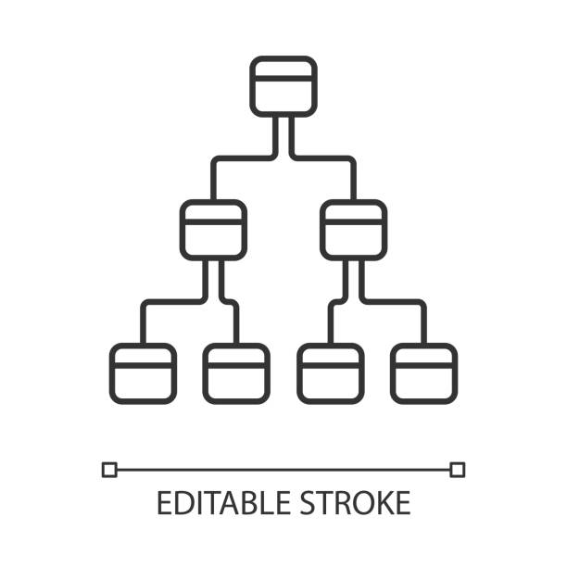
Flow of CDS Views in Hierarchy
The business objects are the basic units of the BOPF-based programming model. Business applications or processes operate on certain business objects.
A business object is represented as a hierarchical tree of nodes. A single node includes a set of semantically related business object data and the corresponding business logic.
On the technical level, each node is implemented with a regular Dictionary table, where each node instance corresponds to a single table entry (table rows).
Nodes, attributes, and alternative keys set up the data part of a business object. Again from a technical viewpoint, attributes form the columns of the table. A node serves as an anchor point for connecting the business logic of the business object.
For each node, several types of entities can be defined to form the specific business logic part of a business object.

Slide 13
Node of Business Object
Node Entity ...is used...
Action
... to implement a service (operation or behavior) of a business object. An action is explicitly triggered by a service consumer, such as the user interface.
Determination
... to provide functions that are automatically executed as soon as certain trigger conditions are fulfilled. A determination is triggered internally due to changes made to the instance of a business object.
Validation
... to either validate whether a specific action can be executed on a specific node instance (action validations) or whether a set of node instances is consistent (consistency validations).
Query
... to search for business object instances that meet certain search criteria.
Authorization Check
... to provide an authorization concept for BO nodes (for their data and for the operations on their data).
Association
... to connect business object instances that are located on different nodes.

Slide 14
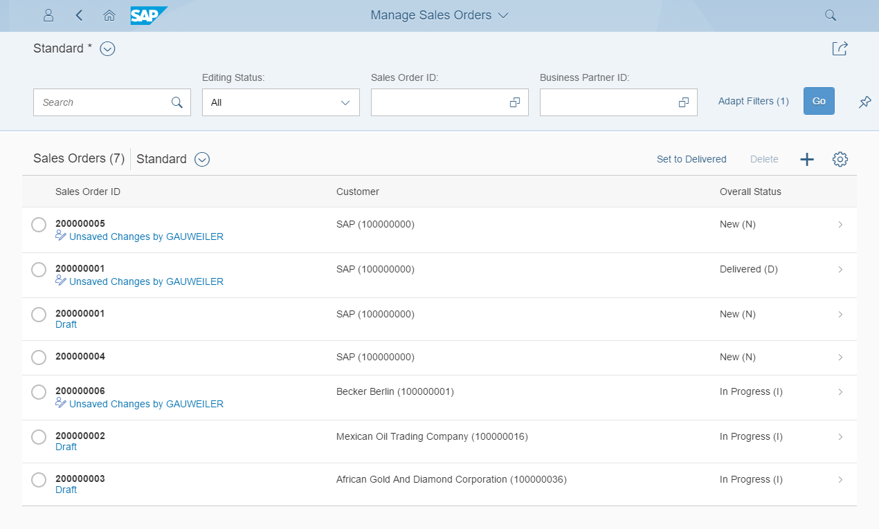
Development flow & Artifacts
BOPF (Business Object Processing Framework) is a framework for working with the BO (Business Objects). BO is a representation of a type of uniquely identifiable business entities described by a structural model, an internal process model, and one or more service interfaces.
consume
SAP Fiori Elements, …
OData Service
Consumption view
ption view
Search Object(s)
Core Data Services
generate / publish
Subnode consumption view
Subnode consumption view
Subnode consumption view
Subnode consumption view
Metadata Extension
enrich
Data Definition
BOPF Business Object
generate
implement
Custom ABAP Business Logic
CDS metadata extensions can currently only be created for CDS views. A CDS metadata extension is a CDS object that is defined and transported in a separate CDS source code.
Draft table
Database table
Draft table
Draft table

Slide 15
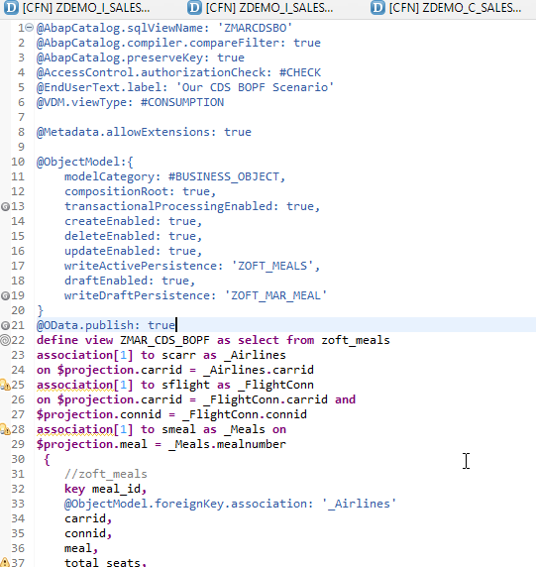
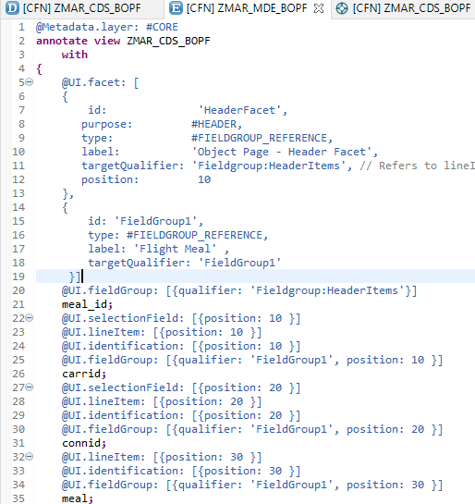
Transactional UX App with CDS & BOPF
Exercise:-
CDS BOPF Scenario
Annotate BO

Slide 16

End of Day 16
Trainer: Anubhav Oberoy

Slide 17

Trainer: Anubhav Oberoy

Slide 18
THANK YOU
If you cannot do
great things, do small things in a great way.
Anubhav Oberoy
https://www.anubhavtrainings.com

Slide 19


We’re committed to empower you to be
Most Desirable Resource
through powerful training solutions.
We build the workforce of the future.
250+
Corporate Clients
30,000+
Learners Trained
25000+
Learners Placed
FREE WEBINARS
Sign up for free webinars with industry experts every fortnight!
Enroll Now!
Contact us today!
https://anubhavtrainings.com/

Slide 20




More from AnubhavTrainings.com

